Slide 1
BANKING SECTOR
Indian Banking System
Commercial vs co-operative banks
How Banks Work
CRR vs SLR
Assets and Liabilities

Slide 2
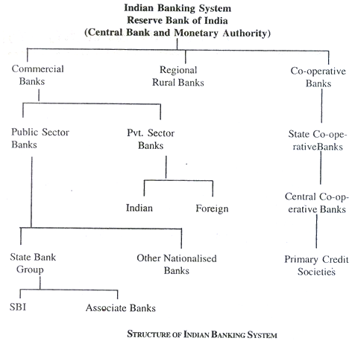
Indian Banking System

Slide 3
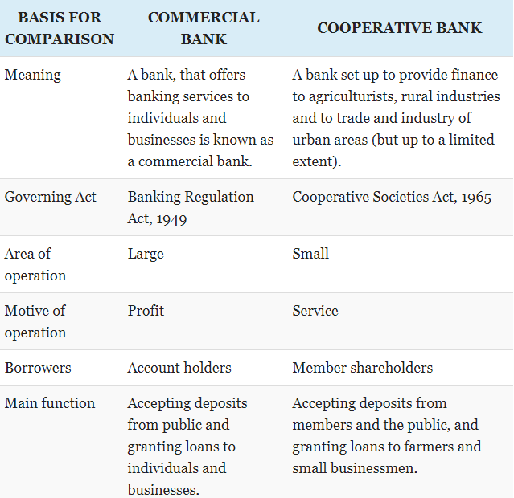
Commercial vs Co-operative Banks

Slide 4
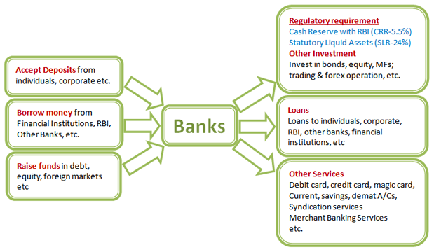
How Banks Work

Slide 5
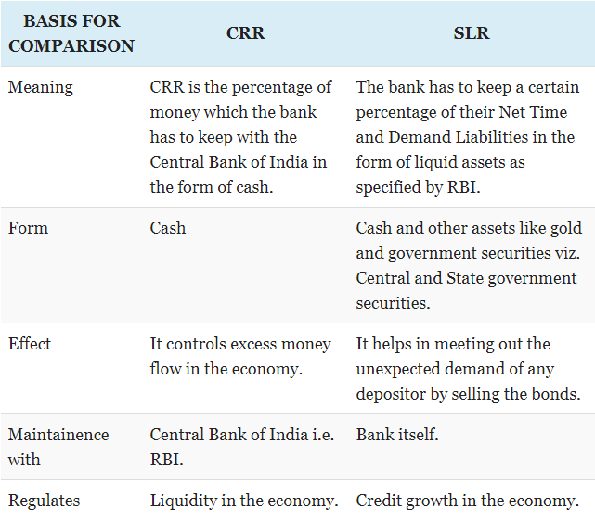
CRR vs SLR

Slide 6
Assets and Liabilities
Anything that puts money in your pocket is an asset and anything that takes away money from your pocket is a liability.
Banks accept deposits for which they are obligated to pay interest this is therefore a liability for the bank, on the other hand Banks offer loans to the customers for which they receive interest this is an asset for the Bank.
Asset Liability management is the process of managing the use of assets and cash flows to reduce the firm’s risk of loss from not paying a liability on time.
Betterment in liabilities leads to betterment in assets.
Assets Examples – Personal loans, car loans, education loans, credit cards etc.
Liabilities Examples – Savings account, fixed deposits, recurring deposits etc.

